Slide 1
Building Web Application-2

Slide 2
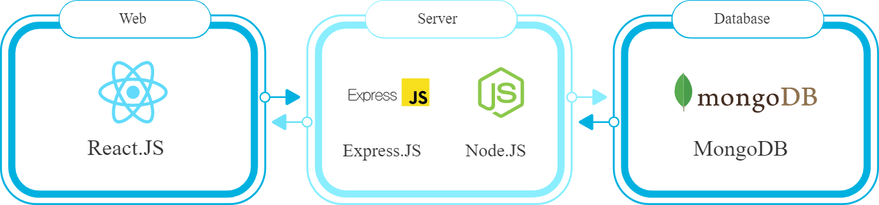
MERN STACK ARCHITECTURE

Slide 3
Lets begin the journey
Install VSCode
Install NodeJS
Unfold nodejs
Use OS module
Use FS module
Use async and await

Slide 4
Project Structure
Install
Before you start, you need to install a few dependencies on your computer:
Express Middleware
Install the first 3 middlewares to run your App:
Express: an essential framework for NodeJS to start a server project.
esm: This goes with babel, which you will install later, and allows you to run ES6 (New version of Javascript).
nodemon: This is my favorite; it will enable you to restart the server automatically whenever you make changes in the server.
Now, your package.json will look something like

Slide 5
Package.json
{ "name": "tutorial", "version": "1.0.0", "description": "mern stack basics", "main": "app.js", "scripts": { "start": "node app.js", "test": "echo \"Error: no test specified\" && exit 1" }, "author": "", "license": "ISC", "devDependencies": { "nodemon": "^2.0.19" }, "dependencies": { "node-fetch": "2.0" }}

Slide 6
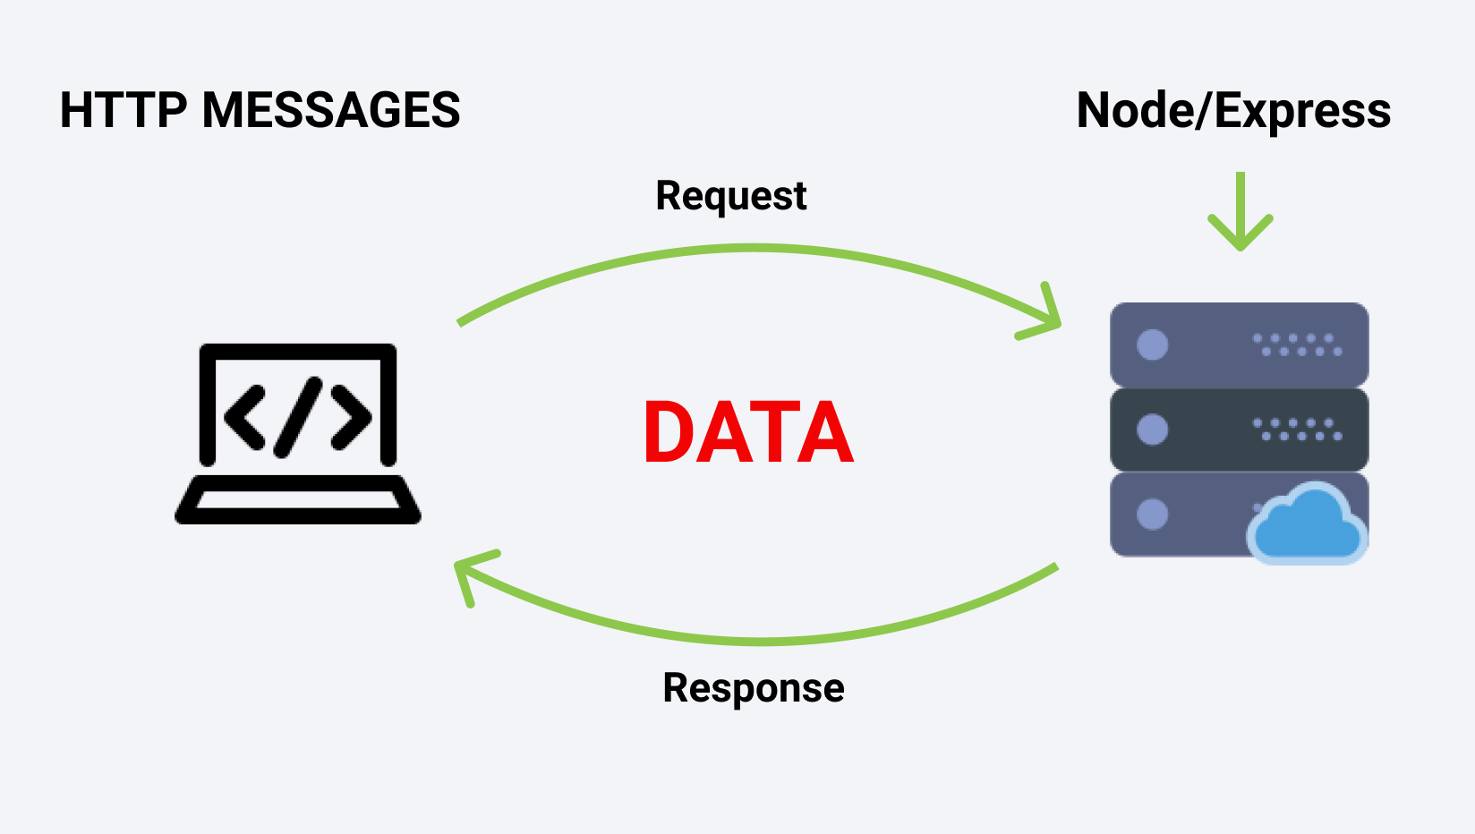
Web Application Architecture

Slide 7
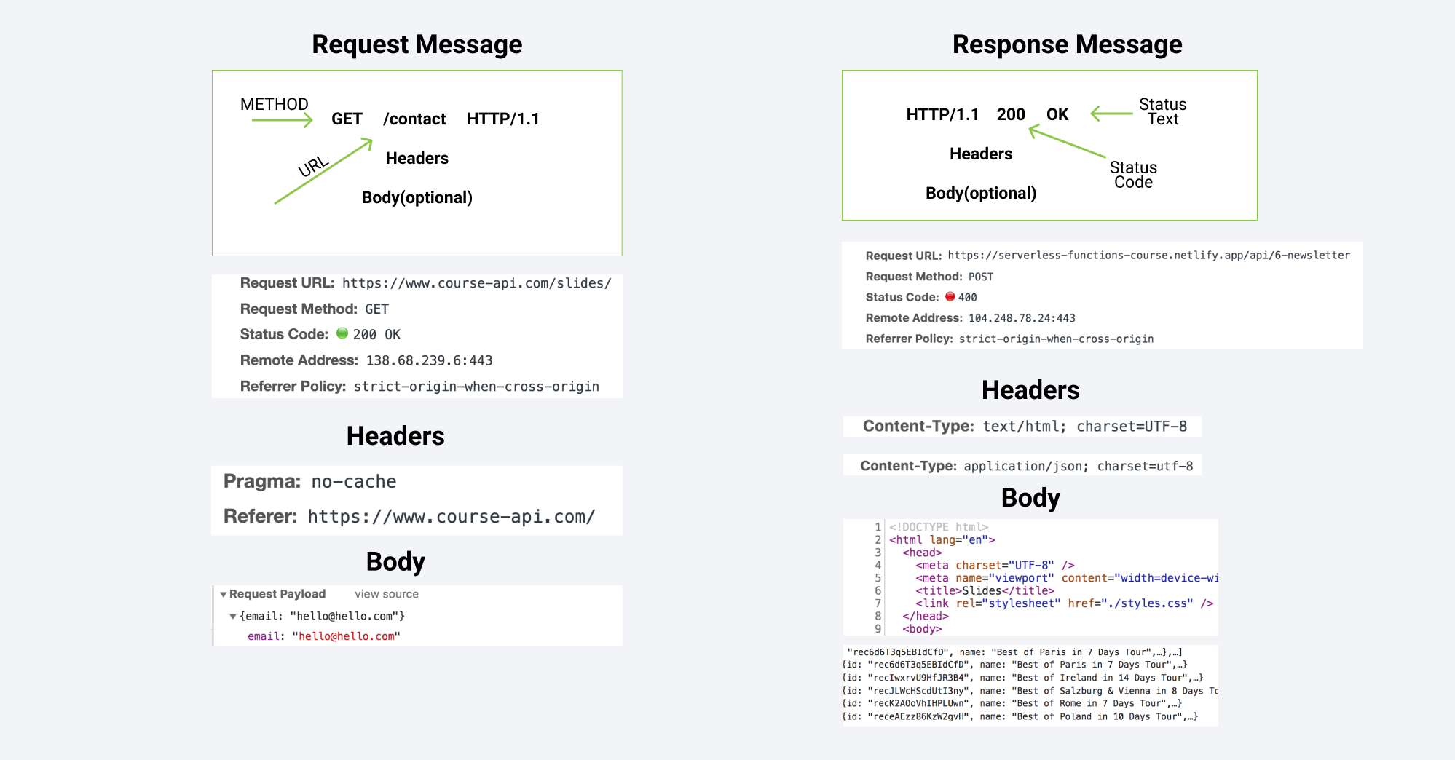
HTTP Request and Response

Slide 8
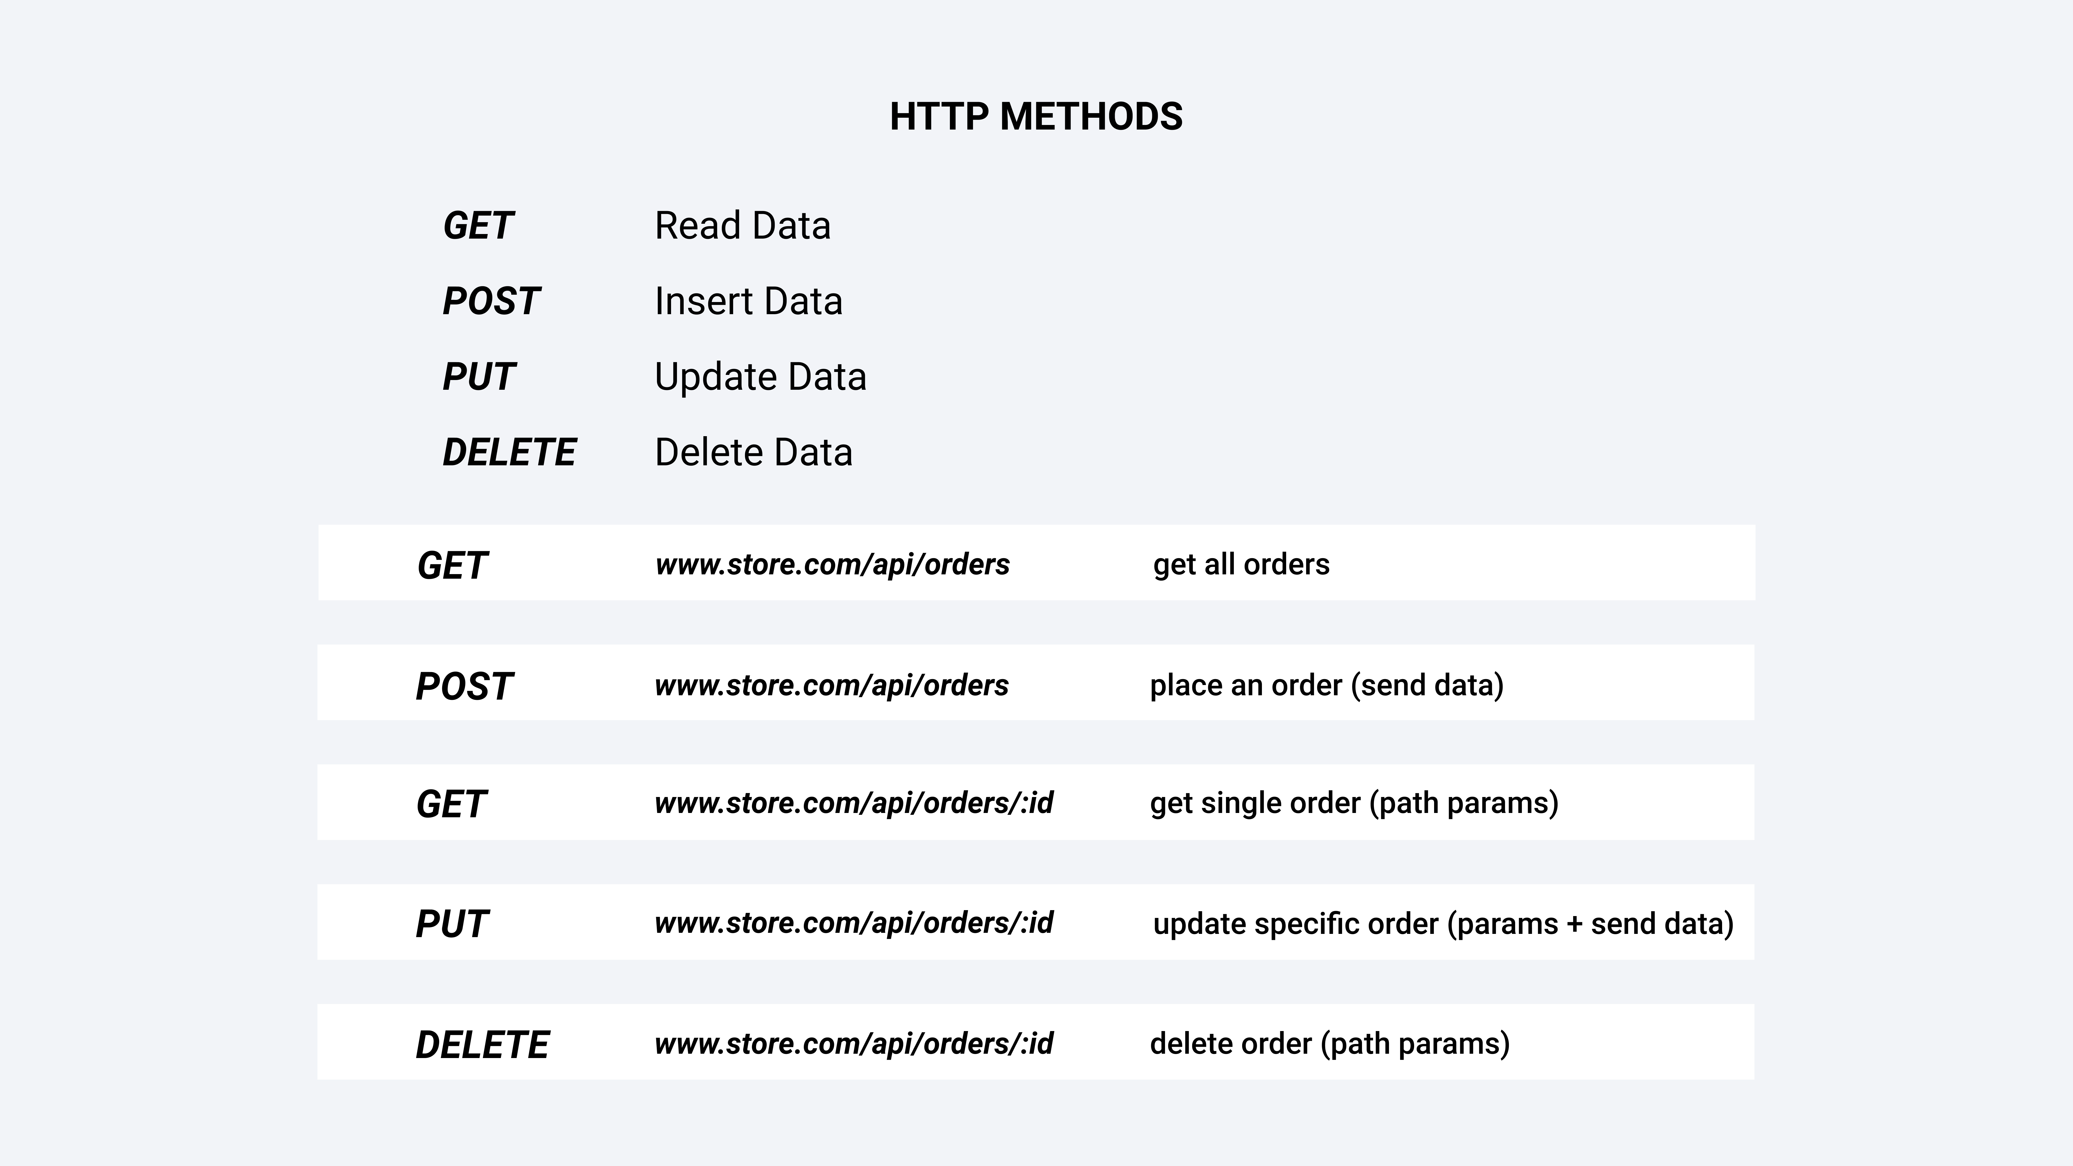
HTTP METHODS

Slide 9
Project Structure
Install
Before you start, you need to install a few dependencies on your computer:
Express Middleware
Install the first 3 middlewares to run your App:
Express: an essential framework for NodeJS to start a server project.
esm: This goes with babel, which you will install later, and allows you to run ES6 (New version of Javascript).
nodemon: This is my favorite; it will enable you to restart the server automatically whenever you make changes in the server.
Now, your package.json will look something like

Slide 10
Lets build the server…
{
"name": "tutorial", "version": "1.0.0",
"description": "mern stack basics",
"main": "app.js",
"scripts": {
"start": "node app.js",
"test": "echo \"Error: no test specified\" && exit 1"
},
"author": "",
"license": "ISC",
"devDependencies": {
"nodemon": "^2.0.19"
},
"dependencies": { // third party dependencies }}

